Slide 1
Promotion of women’s rights in Africa: Key Principles
African court coalition : Training on the Rights of Women and Engagement with the African Court on Human and Peoples’ Rights
28-29 NOVEMBER 2022
DR ruth nekura

Slide 2
Background
Why do we have an African human rights system?
Why do we have specific women’s rights norms?

Slide 3
Road map
Key concepts & principles
Gender transformative continuum
Normative standards
Role of different actors in collectively engaging the African Court

Slide 4
Key concepts & principles
Gender Equality?
Intersectionality?
Formal Equality vs Substantive equality?
4. Gender transformative change?

Slide 5
Discrimination
”Discrimination against women” means any distinction, exclusion or restriction or any differential treatment based on sex and whose objectives or effects compromise or destroy the recognition, enjoyment or the exercise by women, regardless of their marital status, of human rights and fundamental freedoms in all spheres of life;
- Civil, political, economic, social, cultural life etc
Art 1(f) Maputo Protocol

Slide 6
Gender Equality
Is a standard that refers to the equal rights, responsibilities and opportunities of women and men, girls and boys. Equality does not mean that womn and men will become the same but that human rights, responsibilities and opportunities will not depend on how someone is born or sex assigned at birth.
Notes:
All these are ideologies. They are ways of thinking, school of thoughts, theories a system of ideas.
GA: Oftenly it is used to assess how gender mainstreaming is done in an organisation

Slide 7
Women?
Women are diverse and experience intersecting discrimination on the basis of multiple social axes of power, especially, rural urban divide, socio-economic status, health status (HIV), age, race, disability, sexual orientation other vulnerabilities such as the experiences of teenage mothers and sex workers.

Slide 8
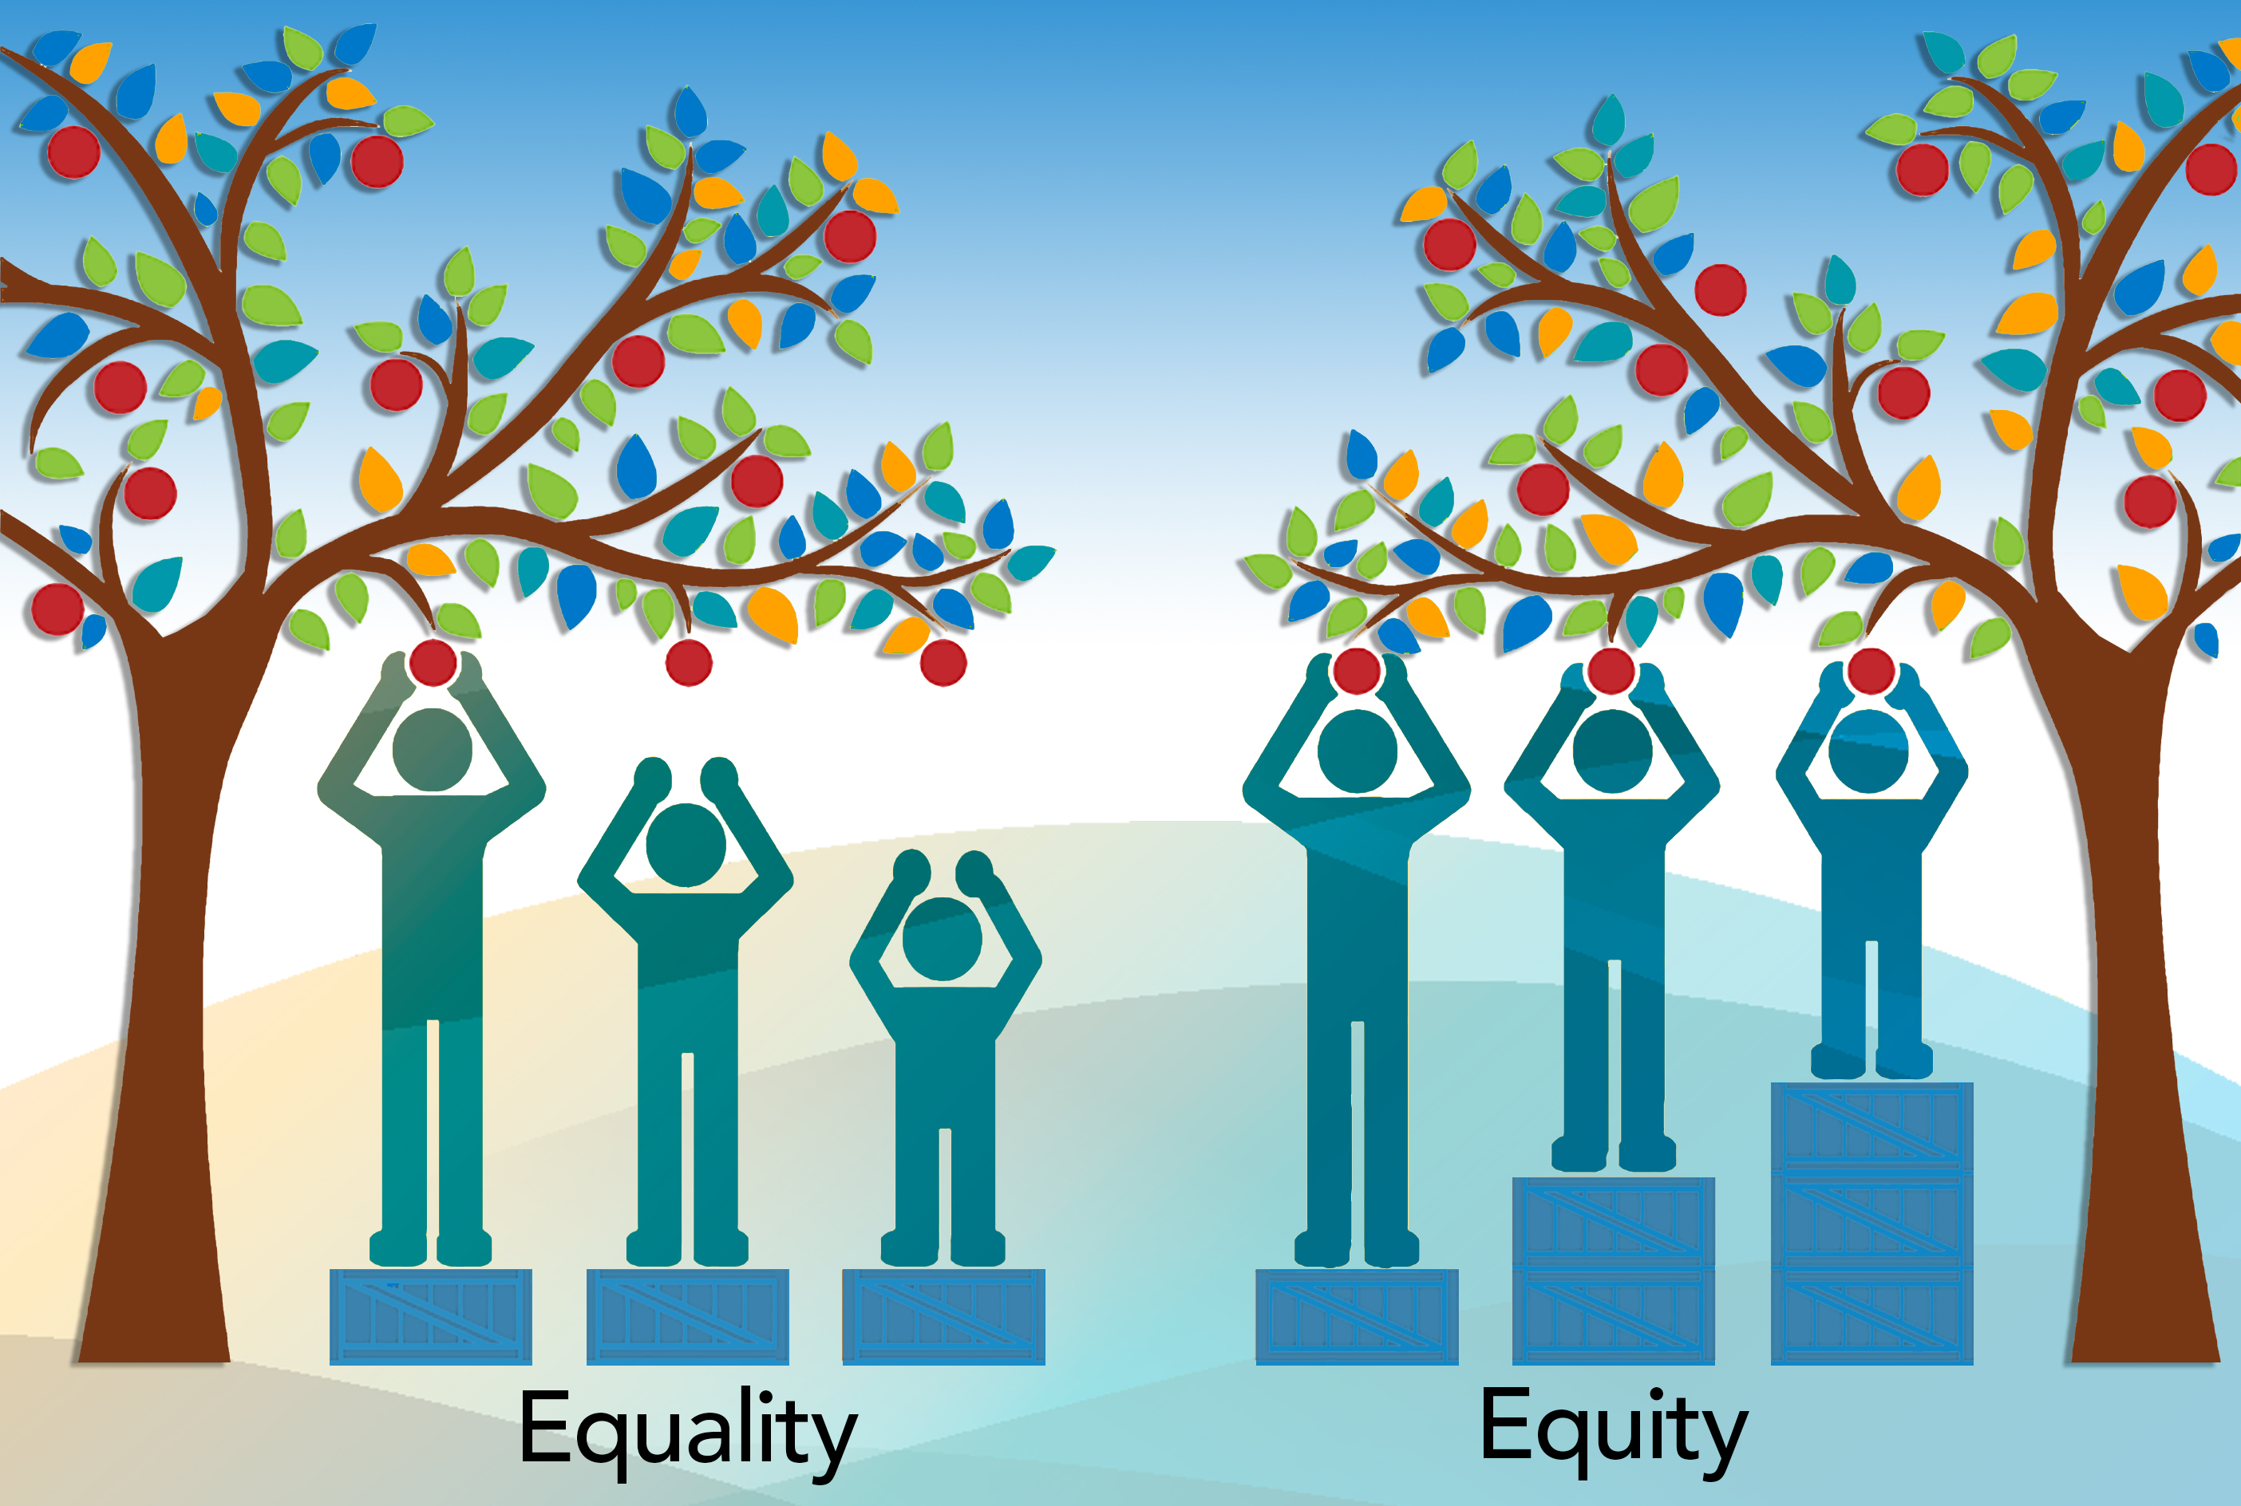
Equality ≠ Sameness
Equality was traditionally understood only as formal equality (CEDAW)
Use of male comparator: The use of Men as the standard of labelling
Process of achieving equality became likened to womn and men being the same, treating people the same irrespective of gender – formal equality
Substantive equality- Appreciation of difference. It is about access to equality of opportunities and equality of outcomes.
Notes:
Use of male comparator: The use of Men as the standard of labelling for example men are often described as normal and womn who do not perform physically, mentally as abnormal because men have been used as the standard for this description.
Substantive equality- Appreciation of difference. And equality of opportunities and outcome. Men and Womn differ in many aspects in what they do reproduction, access to opportunities, access to power and other resources, lived experiences

Slide 9
Formal equality vs Substantive equality

Slide 10
Formal Equality
Formal equality as ‘like treatment’ or gender neutrality therefore non-transformative
A critique of formal equality and its inability to resolve deeply entrenched, systemic or complex patterns of group disadvantage
Formal equality casts women as homogenous thereby invibilising other factors of discrimination beyond sex
Formal equality lends itself to the use of a male comparator in assessing discrimination. A male comparator approach can obscure discrimination

Slide 11
Substantive Equality
Substantive equality as a response to the limitations of formal equality. Contextualises discrimination from resultant inequalities
Substantive equality’s ability to respond to gender based (not sex) inequalities. A gender-based perspective introduces social relations and hierarchies which often underlie women’s rights discrimination and violations
Substantive equality can respond to women’s lived realities and their contexts (recognises women as a non-monolithic group)

Slide 12
Gender transformative continuum
How do you assess the path of progress to gender equality?

Slide 13
Gender Aware/Sensitive
The act/omission considers gender equality but its incorporation into actual work processes and program implementation is very limited.
Gender Responsive
Gender Blind/ Neutral
Gender considerations are ignored all together. There is no deliberate effort to take into account rights; entitlements; obligations; and unequal power relations in interventions.
The act/ommision acknowledges gender inequalities and seeks to develop actions that adjust to or compensate for them. However these interventions do not target systemic change, instead they seek to only limit harmful effects.
The Gender Transformative Integration Continuum
Gender Exploitative/Harmful
The act/ommission is intentionally or unintentionally reenforcing gender inequalities and stereotypes and ultimately exacerbating inequalities.
.
Gender Transformative
The act/omission is conscious, actively strives to understand, examine, question and change rigid gender norms and power inequalities; its interventions leads to actual shift in gender relations, interpersonally and at a structural level

Slide 14
Reflections
Questions for clarification

Slide 15
Health Break- 5 minutes

Slide 16
Normative standards

Slide 17
African Human Rights System – Select Overview
Normative framework
African Court’s Protocol (Protocol to the African Charter on Human and Peoples’ Rights on the Establishment of the African Court on Human and Peoples’ Rights)
Maputo Protocol (Protocol to the African Charter on Human and People’s Rights on the Rights of Women in Africa)
African Charter on the Rights and Welfare of the Child
AU Convention for the Protection and Assistance of Internally Displaced Persons (Kampala Convention)
Protocol to the African Charter on the Rights of Persons with Disabilities
Protocol to the African Charter on the Rights of Older Persons
African Charter on Human and Peoples’ Rights

Slide 18
International Frameworks
Convention on the Elimination of All Forms of Discrimination Against Women
Convention on the Nationality of Married Women
Convention on the Political Rights of Women
Convention for the Suppression of the Traffic in Persons and of the Exploitation of the Prostitution of Others
International Covenant on Civil and Political Rights(arts. 2, 3 and 26)
International Covenant on Economic, Social and Cultural Rights (arts. 2, 3 and 7(i))
United Nations Standard Minimum Rules for the Treatment of Prisoners (paras. 6, 8, 23 and 53)
Universal Declaration of Human Rights

Slide 19
UDHR
Article 1:
“All human beings are born free and equal in dignity and rights”, while
Article 2:
“everyone is entitled to all the rights and freedoms set forth in this Declaration, without distinction of any kind, such as race, colour, sex, language, religion, … birth or other status”
Notes:
The UDHR constitutes the first global expression of rights to which all human beings are inherently entitled to. It acknowledges that men and women are not the same but they have the right to be treated equally and without discrimination.
Article 1 provides the first and most encompassing reference to gender equality: “All human beings are born free and equal in dignity and rights”, while Article 2 specifically states the right to be free of discrimination based on the grounds of sex, among others: “everyone is entitled to all the rights and freedoms set forth in this Declaration, without distinction of any kind, such as race, colour, sex, language, religion, … birth or other status”.

Slide 20
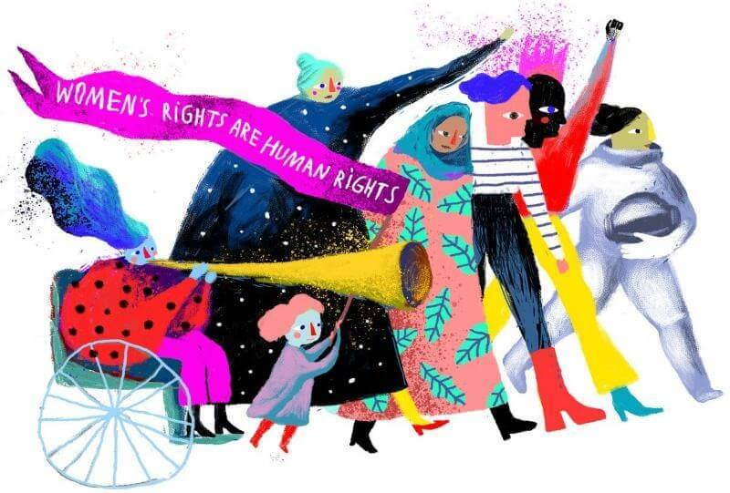
CEDAW
Principle of substantive equality
Principle of non-discrimination
Liability of states
Photo credit: UN Women Ukraine
Notes:
Also known as the bill of rights for women, CEDAW is a dynamic human rights instrument that is exclusively devoted to gender equality. It defines what constitutes discrimination against women (Art. 1) and sets an agenda for states on how to end it and achieve substantive equality. Ask for a volunteer to read the definition aloud.
CEDAW is a normative, legally binding document for states to fulfil, protect and respect women’s human rights, against abuses and violation committed by both state and not state actor(s).
2019 marked 40 years since its adoption by the General Assembly in 1979.
The below link is to a short video that introduces one of the three key principles that underpin the CEDAW, the principle of non-discrimination: https://www.youtube.com/watch?v=OBdDB5PKrmk

Slide 21
The Principle of Equality & Non-Discrimination
Four dimensions:
Redressing disadvantage
Countering stigma, discrimination, prejudice and violence
Transforming social and institutional structures
Facilitating social and political participation
Notes:
The principle of equality is central to all international human rights instruments. Equality however is often generically referred to as equality before the law, or equality of opportunity, without sufficient consideration to the fact that equality of treatment in a context of chronic, deep-rooted disadvantages may simply perpetuate the disadvantage itself (equality of results).
Hence the importance of looking into the four following dimensions:
Redressing existing disadvantages, which may also mean applying different treatment where needed, including extending benefits, incompatible with a levelling down approach.
Counter stigma, prejudice, discrimination and violence.
Transform institutional structures, changes are needed in terms of redistribution of power and resources, and must be structural, not just at the individual levels.
Enhance social and political participation as essential to women’s agency and voice.

Slide 22
Temporary Special Measures

Slide 23
Using Strategic Litigation to advance Women’s Rights
ISSUES
1. Discrimination in law and fact
2. Dignity
3. Life, integrity and security of the person
4. Freedom from violence against women
5. Harmful practices
6. Equal rights in mariage
7. Equal rights in seperation, divorce and annulent of mariage
8. Access to justice and equal protection before the law
9. Participation in political and desicion making process
10. Right to peace
11. Protection in armed conflicts
12. Education and training
13. Economic and sociol welfare rights
14. Health and reproductive rights
15. Food security
16. Adequate housing
17. Right to positive cultural context
18.Healthy and sustainable environment
19. Widow’s rights
20. Inheritance
21.Special protection of Elderly women, women with disabilities, women in distress

Slide 24
Group Work: “A Call 2 Action”
What women’s rights issues calls for our urgent intervention within our country context? (after discusing, select one issue)
Bring a case to the African Court of Human and Peoples’Rights from the issue selected above:
- What types of human rights violations can be alledged?
- What Remedy will you seek from the court?

Slide 25
Health Break- 15 minutes

Slide 26
Groups Feedback

Slide 27
Reminder
Why do we have an African human rights system?
Why do we have specific women’s rights norms?

Slide 28
NB: The ACC as a strategic platform
The ACC is best placed to: Strengthen the effectiveness of the court to promote and protect human rights in Africa
Support advocacy and lobbying for the ratification of the Protocol establishing the court
Full participation of civil society in the nomination of judges
Transparency in nomination and election of candidates to the African Court
Promote direct access to the court for individuals, groups, NGOs
Monitoring the developments in standards to ensure alignment with other regional & international standards
Implementation of decisions from the court

Slide 29
The ACC creates opportunity for:
Creation on an enabling environment for the effective functioning of the court
Independence and impartiality of judges
Cross-pollination of practices and knowledges across other judicial/quasi-judicial mechanisms in Africa
CSOs and other actors input in process of developing rules of procedure that guarantee effectiveness of the court

Slide 30
Group Work: "Collective Action”
What are the challenges standing in the way of effectiveness of the African court to fully address women’s rights violations in Africa?
What is the role of the different actors? & how can different actors (NHRI’s, CSOs, individuals, progressive states) collectively strengthen the effectiveness of the African Court?

Slide 31
African Human Rights Mechanisms 29th Nov 2022

