Slide 1
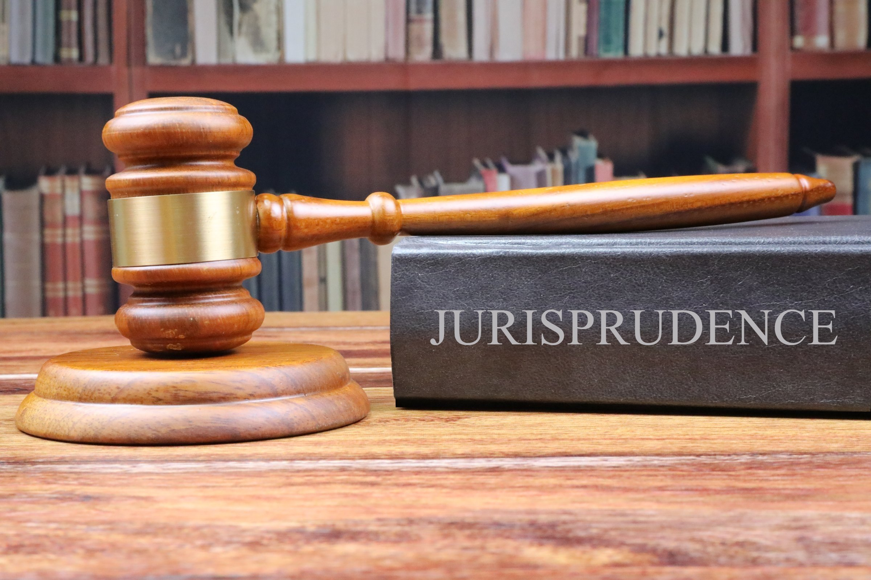
Mary Kimemia ~ Legal Equality, Africa

Slide 2
Cases from the African Human Rights System
African Court on Human and People’s Rights
African Commission on Human and People’s Rights
National/
Domestic Courts
ECOWAS Court of Justice

Slide 4
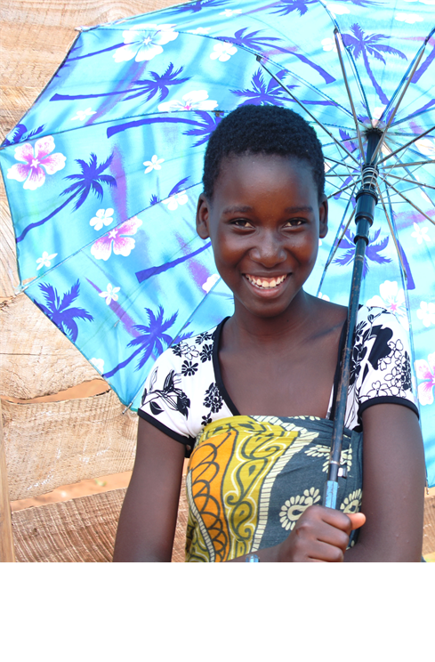
Tike Mwambipile and Equality Now Vs the United Republic of Tanzania
The practice of excluding pregnant girls and young mothers from school is not new to Tanzania.
A 2002 amendment to the Education Act, Government Notice No. 295, led to the adoption of Regulation 4 of the Education Act (Expulsion and Exclusion of Pupils from Schools) Regulations allow expulsion based on ‘’an offence against morality’’ or where a pupil has entered into wedlock.
The practice was exacerbated in June 2017 by top-level government officials, including the late President of the United Republic of Tanzania John Pombe Magufuli, made public statements vowing to intensify efforts to expel pregnant students and ensure that they cannot re-enter school after giving birth.
‘’In my administration, as long as I am president ... no pregnant student will be allowed to return to school. We cannot allow this immoral behavior to permeate our primary and secondary schools ... never.”
22nd June 2017, the late President Magufuli

Slide 5
Tike Mwambipile and Equality Now Vs the United Republic of Tanzania
Then–Home Affairs Minister Mwigulu Nchemba threatened to deregister non-governmental organizations (NGOs) that campaign for teenage mothers to be allowed back to school.
National, regional and international advocacy bore little fruit including the World Bank’s withholding of a $500million education loan from November 2018 – March 2020 re. alternative education pathways.
Tanzania ratified Protocol to the African Charter on Human and Peoples’ Rights on the Establishment of an African Court on Human and Peoples’ Rights and made a declaration under Article 34(6) of the Protocol on 29th March 2010; withdrawn 21 Nov 2019.
Right to education is not a right that can be decided by a court in Tanzania.
“These NGOs should go out and open schools for parents. But they should not force the government to take back the pupils…. Giving out free education for students who have really decided to go and study, and now you want me to educate the parents?” 22nd June 2017, late President Magufuli

Slide 6
Tike Mwambipile and Equality Now Vs the United Republic of Tanzania
Prayers Sought
Declaration that the exclusion and expulsion of pregnant girls and adolescent mothers from accessing public education violates the right to education.
Declaration that the Policy is grossly unlawful, discriminatory and not in the best interest of the child.
Order that the prohibitive policy be immediately revoked and that the Respondent State amend its legislation to protect the right to education.
An order to repeal Regulation No. 4 of the Education Regulations (Expulsion and Exclusion of Pupils from Schools) of 2002 to remove ‘’immorality’’ and “wedlock” as a ground for expulsion and amend the Marriage Act of 1971 to harmonize the age of marriage to 18 for both boys and girls;
An order that the Respondent State addresses the issue of teenage pregnancies and child marriages through public education, or awareness on sexual and reproductive health and rights.

Slide 7
Tike Mwambipile and Equality Now Vs the United Republic of Tanzania
Prayers Sought
An order that the Respondent State develops strategies to enable teenage mothers to attend school.
Respondent puts in place constitutional and legislative and administrative measures to guarantee the right to education including its enforceability domestically as well as a right to remedies including reparations ability and eradicate discriminatory laws and policies that impede the right to education within six (6) months.
An order that the Respondent reports to the Honourable Court, within a period of six (6) months from the date of the judgment issued by the Honourable Court, on the implementation of this judgment and consequential orders;
An Order that the Respondent state to publish this judgement in the official website of Respondent Judiciary, and Minister Responsible for legal affairs, within 2 Months from date of notification of decision.

Slide 8
Tike Mwambipile and Equality Now Vs the United Republic of Tanzania
Legal Basis
Art 12 in its entirety but more so Art 12 (2)(c).
“promote the enrolment and retention of girls in schools and other training institutions and the organization of programs for women who leave school prematurely.”

Slide 9
Tike Mwambipile and Equality Now Vs the United Republic of Tanzania
Status
Amici Curiae: Amnesty International. Centre for Human Rights and Good Governance, Tanzania Women Lawyers Association, Msichana Initiative, United Nations Educational, Scientific and Cultural Organization, Clooney Foundation for Justice, Women’s Link Worldwide.
10 September 2021: Reply to the application filed
21 February 2022: Court wrote a proposal for amicable settlement to Equality Now
April 2022: Response filed to State’s reply and to proposal

Slide 10
Tike Mwambipile and Equality Now Vs the United Republic of Tanzania
Impact
The Tanzanian government announced the lifting of the controversial ban on teenage mothers continuing their education.
Girls will have two years in which to return to school after giving birth. However, the move is not legally binding and girls will continue to be banned from class while pregnant.
“Pregnant schoolgirls will be allowed to continue with formal education after delivery..”
Education Minister, Joyce Ndalichako

Slide 12
D.R. Congo v. Burundi, Rwanda and Uganda (Comm. No 227/99)(2003)
Background
Armed forces of the Republics of Burundi, Rwanda and Uganda were present in provinces of DRC, under the pretext of safeguarding their interest, where there had been rebel activities.
These forces raped and killed Congolese women. In addition to these violations, the Rwandan and Ugandan forces specifically aimed at spreading HIV/AIDS through the rape of Congolese women and girls in order to decimate the local population..

Slide 13
D.R. Congo v. Burundi, Rwanda and Uganda (Comm. No 227/99)(2003)
Judgment
The African Commission found that these particular acts violated Art 2, 4, 5, 12(1&2), 14, 16, 17, 18(1&3), 19, 20, 21, 22 and 23 of the African Charter. They further found that the violations were contrary to the provisions and international human right standards set out in the Geneva Conventions and, the Convention on the Elimination of All forms of Discrimination Against Women(CEDAW).
Had the Maputo Protocol come into force at the time of filing and determination of the case, the violations raised would have fallen under Art 3 (right to dignity), 4 (right to life, integrity and security of person), and 11 (protection of women in armed conflict).

Slide 14
Equality Now & Ethiopia Women Lawyers Association v. Federal Republic of Ethiopia (Woineshet Case)
Background
A 13 year old girl named Woineshet was abducted and raped. She was later rescued by police and her perpetrator arrested but later on released on bail.
After his release, Woineshet was abducted, again, and forced to sign a marriage certificate; marrying her to her perpetrator. After a month of being in the forced marriage, having suffered detention and multiple counts of rape, Woineshet escaped.
The perpetrator was re-arrested and sentenced to 10 years and his co-perpetrators charged with abduction and sentence to 8 years imprisonment.
The decision was successfully appealed and the judgment overturned. The judged cited that Woineshet consented to the acts and further stated that no one would rape a woman who was not a virgin.
Woineshet’s lawyers unsuccessfully filed two appeals to this decision.
Equality Now and the Ethiopian Women Lawyers Association took Woineshet’s case to the African Commission on Human and Peoples’ Rights (the “Commission”) in 2007 on her behalf calling on the Ethiopian government to ensure that justice prevailed for her.

Slide 15
Equality Now & Ethiopia Women Lawyers Association v. Federal Republic of Ethiopia (Woineshet Case)
Judgment
In 2016, nine years later – and fifteen years since Woineshet was raped, the African Commission ruled that Woineshet should be compensated with $150,000 and that Ethiopia should implement “escalated and targeted measures” to deal with "marriage" by abduction and rape.

Slide 16
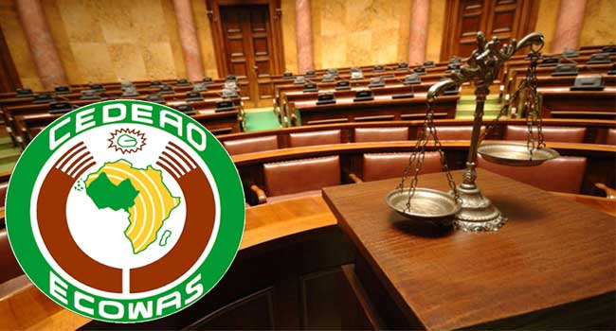

Slide 17
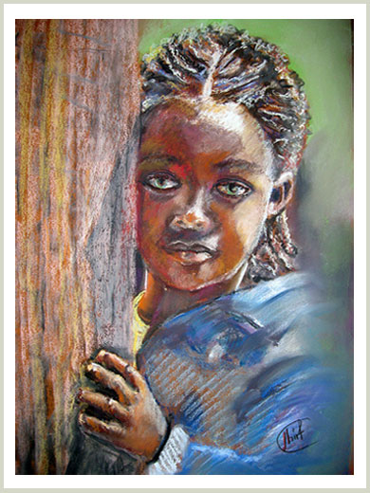
WAVES & Child Welfare Society v. the Republic of Sierra Leone
Full Citation
Women Against Violence and Exploitation in Society (WAVES) and Child Welfare Society, Sierra Leone (CWS-SL) (on Behalf of Pregnant Adolescent School Girls in Sierra Leone: Equality Now as agents of the girls) Versus the Republic of Sierra Leone
The Community Court of Justice of Economic Community of West African States (ECOWAS) Suit No: ECW/CCJ/APP/22/18, Judgment No: ECW/CCJ/JUD/37/10 - 12th of December, 2019

Slide 18
WAVES & Child Welfare Society v. the Republic of Sierra Leone
Background
Following the outbreak of the Ebola pandemic in 2014, schools were closed from June 2014 to April 2015. This saw an increase in teenage pregnancies owing to heightened vulnerabilities and exploitations.
In April 2015, the Minister of Education, Science and Technology Dr. Minkailu made a public statement directing that all ‘’visibly pregnant school girls’’ would not be allowed to be in school and that they would be “provided skills and basic knowledge in parenting” and “training and basic knowledge in literacy and numeracy.”
This statement revived a policy banning pregnant girls from school, and the government established separate schools for them that only met three days per week and only taught four subjects. This ban also increased stigma against the pregnant girls.

Slide 19
WAVES & Child Welfare Society v. the Republic of Sierra Leone
Issues
Was there evidence of a ban from by the Respondent barring pregnant adolescent school girls from attending school in Sierra Leone as a result of pregnancy?
From the facts presented by the Applicants, was there discrimination against pregnant school girls in Sierra Leone?

Slide 20
WAVES & Child Welfare Society v. the Republic of Sierra Leone
Was there evidence of a ban from by the Respondent barring pregnant adolescent school girls from attending school in Sierra Leone as a result of pregnancy?
In its defense, the government of Sierra Leone submitted that the statement by the Minister was isolated, done without recourse to the Cabinet, an error in judgment and reversed immediately through establishing separate schools to respond to the fragility of pregnant girls.
To this the court held that:
The Minister’s statement was clear evidence of violation of the right to education and non-discrimination for pregnant girls.
Acts of state officials done in their official capacity are ‘acts of the state’ and attach liability on the state.
The Minister’s statement was attributable and imputable to the State and amounted to an unlawful ban.

Slide 21
WAVES & Child Welfare Society v. the Republic of Sierra Leone
From the facts presented by the Applicants, was there discrimination against pregnant school girls in Sierra Leone?
The actions of the Respondent barring pregnant school girls from attending school amounted to discrimination.
There was no reasonable justification for the differential treatment meted out to the pregnant girls who were in school before becoming pregnant.
State has the responsibility to ensure girls attend schools as boys do; and pregnant girls and teenage mothers attend school just as those who are not do.
Separate schools of less standard and less facilities was unlawful segregation, discriminatory, stigmatizing and could be seen as punishment for pregnancy & a violation of the right to education.

Slide 22
WAVES & Child Welfare Society v. the Republic of Sierra Leone
Legal Basis
The case was anchored on the African Charter on Human and People’s Rights
Art 17(1) – Right to education for every individual
Art 18(3) – Elimination of every discrimination against women and also ensure the protection of the rights of the woman and the child as stipulated in international declarations and conventions
Art 25 – Duty to promote and ensure teaching, education and publication the respect of the rights and freedoms under the Charter.
Other relevant articles under the Maputo Protocol include
Art 2(1) – Elimination of discrimination against women(and girls)
Art 3 – Right to dignity
Art 12 (1)(a) – Elimination of all forms of discrimination against women and guarantee equal opportunity and access in education and training.

Slide 23
WAVES & Child Welfare Society v. the Republic of Sierra Leone
Judgment
The prohibitive policy (the ban) be revoked with immediate effect.
The Respondent State abolish the separate school established for pregnant girls and absorb the already enrolled girls in the mainstream schools.
The Respondent State develops strategies, programmes and nation-wide campaigns that focus on reversing negative societal attitudes that support the discrimination and bias against pregnant girls attending school.
The strategies/programmes must enable teenage mothers attend school and/or develop income-generation driven programmes for pregnant girls.
The Respondent State integrates sexual and reproductive health into school curricula as increased knowledge on family planning and contraceptives will support efforts to address the high rate of teenage pregnancy.

Slide 24
WAVES & Child Welfare Society v. the Republic of Sierra Leone
Impact
The Ministry of Basic and Senior Secondary Education (MBSSE) established a taskforce on Sexual and Reproductive Health to advise the Minister and the government on issues relating to the radical inclusion of women and girls into Sierra Leone’s national development and the right to access education by all girls irrespective of ability, ethnicity, and socio-economic circumstances.
3 Working Groups were established to focus on:
Pregnant girls’ access to education,
Comprehensive Sexuality Education,
Research and data.
“We have a moral and constitutional duty to protect the girl child and to change her outcomes. My government is focused on and committed to inclusive national development meaning the radical inclusion of every citizen regardless of their gender, ethnicity, ability and socioeconomic or other circumstances." President Bio, 13 December 2019

Slide 25
DOMESTIC JURISPRUDENCE :
KENYA

Slide 26
Kamau v. AG and Anti-FGM Board [2021]
Full Citation
Kamau v Attorney General & 2 others; Equality Now & 9 others (Interested Party); Katiba Institute & another (Amicus Curiae) (Constitutional Petition 244 of 2019) [2021] KEHC 450 (KLR) (Constitutional and Human Rights)
Constitutional and Human Rights Court, High Court of Kenya. Constitutional Petition No 244 of 2019

Slide 27
Kamau v. AG and Anti-FGM Board [2021]
Background
Dr. Tatu Kamau challenged the constitutionality of the Prohibition of Female Genital Mutilation Act (No 32 of 2011). She claimed that the FGM Act infringes on the right of women to participate in a culture of their own choice, denies women autonomy over their bodies and denies women their right to the highest attainable standard of health provided for in the Constitution.
The petitioner also alleged that gender discrimination ensues as a result of allowing male circumcision and outlawing ‘female circumcision’.

Slide 28
Kamau v. AG and Anti-FGM Board [2021]
Judgment
In the judgment, the judges made reference to the Maputo Protocol and CEDAW to validate the retrogressive nature of FGM and the need to protect women and girls right to health and to the enjoyment of the highest attainable standard of physical and mental health as entrenched in Article 16 of the (Maputo Protocol).

Slide 30
The Use of the African Court Jurisprudence to Influence Policy Change at the National Level

Slide 31
How to Use Jurisprudence to Influence Policy Change at the National Level
1
Strategic engagements with the government
4
Robust Awareness-raising
2
Training and Capacity-building
5
Engagement at the ACHPR
3
Development of Laws and Policies

Slide 32
GROUP ASSIGNMENT
The African Court on Human and People’s Rights has delivered its judgment in favor of the Applicant in the case of Tike Mwambipile & Equality Now v. the United Republic of Tanzania.
Develop a short, medium and long term plan of action, anchored in this decision, to repeal/amend the 2002 amendment to the Education Act, Government Notice No. 295, that led to the adoption of Regulation 4 of the Education Act (Expulsion and Exclusion of Pupils from Schools) Regulations that allow expulsion based on ‘’an offence against morality’’ or where a pupil has entered into wedlock.

