Slide 1
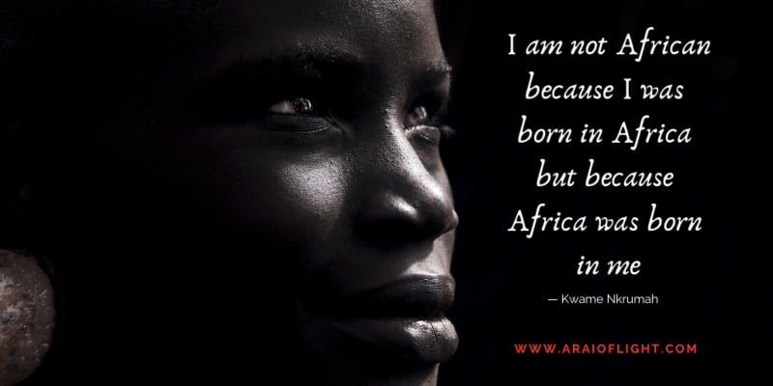
Mary Kimemia ~ Legal Equality, Africa

Slide 2
Protocol to the African Charter on Human and People’s Rights on the Rights of Women in Africa (The Maputo Protocol)
Notes:
Adopted in 2003 and came into force in November 2005.
Discuss the need for Maputo when there is CEDAW.

Slide 3
Fun Facts about the Maputo Protocol
Fastest ratified treaty in Africa
Only treaty that explicitly provides for abortion, right to peace for women and prohibits harmful practices
Specifically mandates the African Court as the court of …
Most comprehensive women’s rights instrument globally
Notes:
Mention some of the reasons why it is the most comprehensive; widow’s rights (Art 20), protection of elderly women (Art 22)

Slide 4
KEY ISSUES HIGHLIGHTED IN THE MAPUTO PROTOCOL
1
INHERITANCE AND PROPERTY RIGHTS
Art 20 on widow’s rights is unique to the Maputo Protocol.
Art 21(1) on right to inheritance further reiterates the protection of widows.
4
REPRODUCTIVE RIGHTS
Art 14 on health and reproductive rights is quite the progressive provision, in the African context, which a several state parties have entered reservations.
2
5
FEMALE GENITAL MUTILATION
Art 5 on the elimination of harmful practices requires state parties to prohibit and condemn, through legislative and other measures, any and all forms of harmful practices affecting women.
Why the focus on FGM?
DOMESTIC VIOLENCE, RAPE AND SEXUAL VIOLENCE
Art 4 on the rights to life, integrity and security of the person comprehensively outlines the obligations of state parties in the protection of women against all forms of violence; in private and in public.
Art 8 on access to justice and equal protection before the law creates an obligation to state parties to ensure that women have access to justice in the event that the rights outlined under Art 4 are violated.
3
CHILD AND FORCED MARRIAGE
The protection of women and girls from child and forced marriage draws from 3 main articles; Art 4, 5 and 6.

Slide 5
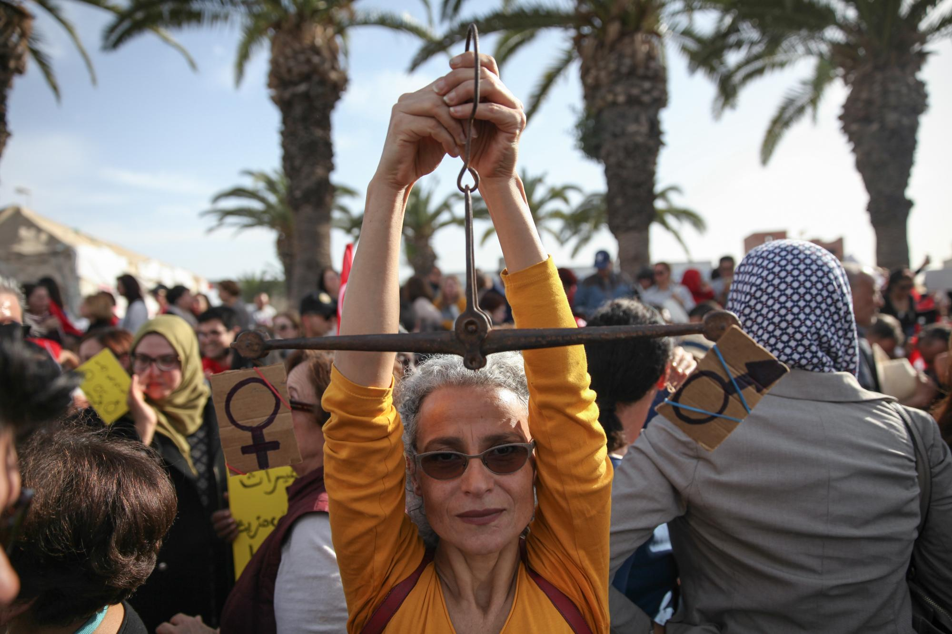
State Party’s Obligations
Violations
Remedies

Slide 6
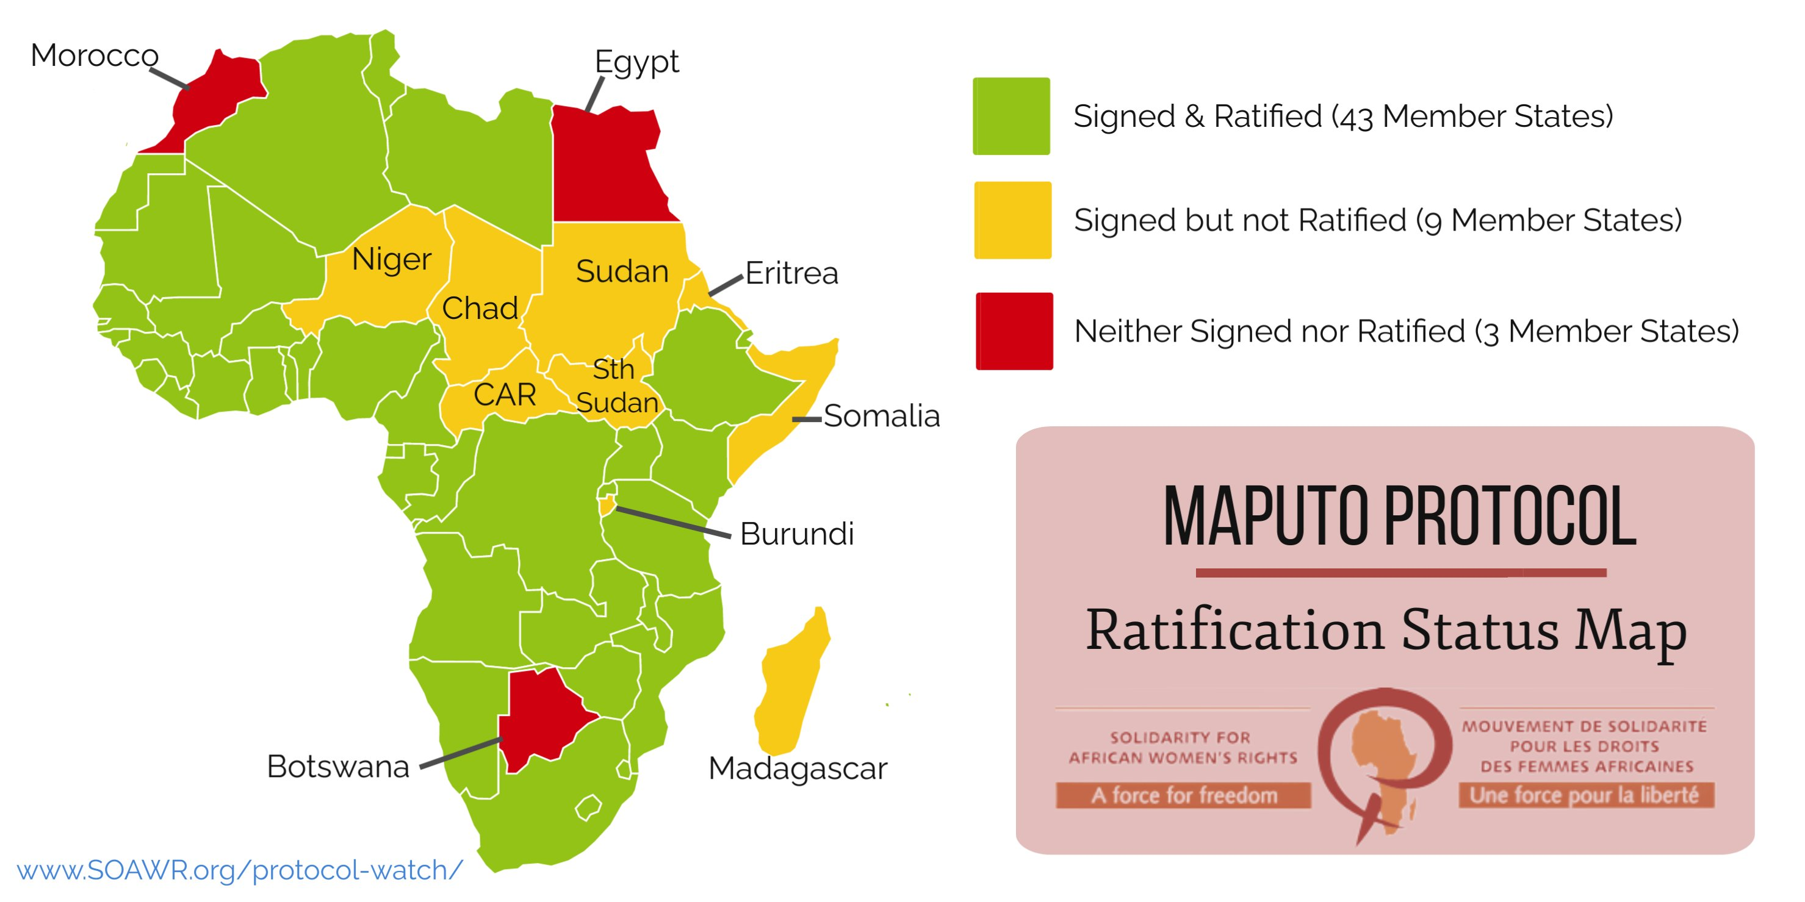
Ratification Status on the Maputo Protocol
In April 2022, the Sahrawi Arab Democratic Republic acceded to the Maputo Protocol.
Although South Sudan is yet to ratify the Maputo Protocol, it has passed a parliamentary motion to ratify.

Slide 7
Reservation Status to the Maputo Protocol
Mauritius has the highest number of reservations to the Maputo Protocol.
Art 4(2)(k) – Ensure women and men have equal rights to access refugee status and that women refugees are accorded the full protection and benefits guarantee under international refugee law including their own identity and documents.
Art 6(b), (c) – The minimum age of marriage for women shall be 18 years and monogamy as the preferred form of marriage.
Art 9 – Right to Participation in the political and decision-making processes.
Art 11(3) – The protection of asylum seeking women, refugees, returnees and IDPs against all forms of violence, rape and other forms of exploitation. Ensure that such crimes are considered crimes against humanity.
Art 14(2) – Adequate, affordable and accessible health services, establish and strengthen pre and post-natal services and authorize medical abortion in cases of rape, incest, sexual assault and where continued pregnancy endangers the mental and physical health of the mother.

Slide 8
Reservation Status to the Maputo Protocol
Kenya’s reservations to the Maputo Protocol.
Art 10(3) – Take necessary measures to reduce military expenditure significantly in favor of spending on social development and promotion of women in particular.
Art 14(2) – Authorize medical abortion in cases of rape, incest, sexual assault and where continued pregnancy endangers the mental and physical health of the mother.
Namibia’s reservations to the Maputo protocol
Art 6(d) – The recording in writing and registration of every marriage in order to be legally recognized.

Slide 9
Reservation Status to the Maputo Protocol
Uganda’s reservations to the Maputo Protocol.
Art 14(1a) – Women’s right to control their fertility.
Art 14(2c) – Authorize medical abortion in cases of rape, incest, sexual assault and where continued pregnancy endangers the mental and physical health of the mother.
South Africa’s reservations to the Maputo Protocol
Art 6(d) – The recording in writing and registration of every marriage in order to be legally recognized.
Art 6(h) – Women shall have equal rights with respect to the nationality of their children except where it is contrary to a provision in national legislation or is contrary to national security interests.

